Slide 1
Modeling with linear Functions
L1.3b

Slide 2
Quick slope review:
Measure of how steep the line is and which direction it tilts
Positive slope is up to the right, negative down to the right
Greater the magnitude (ignoring the sign), the steeper. Smaller magnitude, more flat
Represented by the letter/variable m
Slope is “rise over run”, $m=\frac{rYse}{run}$ … rise is the change in y values, run in x values, 1 point to another
Can be written as $m=\frac{∆y}{∆x}$ where the symbol $∆$ is read as “the change in” … and also as “delta”
Given 2 points from a line$\left(x_{1}, y_{1}\right)and\left(x_{2}, y_{2}\right), m=\frac{y_{2}−y_{1}}{x_{2}−x_{1}}$

Slide 3


$$l_{2}$$
$$l_{1}$$
$$m_{1}=\frac{1}{2}$$
How do you find the slope of the line that is perpendicular to another?
Perpendicular slope: negative reciprocal
…flip the fraction, flip the sign
Example: $m_{1}=\frac{1}{2}$ … the perpendicular slope is $m_{2}=−\frac{2}{1}=−2$
What is the perpendicular slope to $m_{1}=−\frac{7}{5}$?
$m_{2}=+\frac{5}{7}$
$$m_{2}=−\frac{2}{1}$$

Slide 4
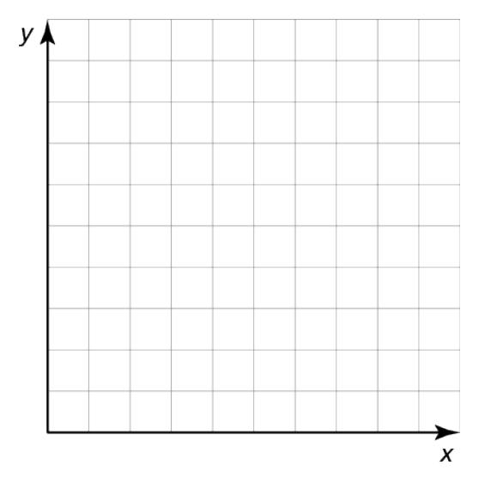
Notes on graphing…
18
What is “different” about this graph?
The scale of the x axis…
Is different than the y axis
16
14
12
10
8
6
4
2
1
2
3
4
5
6
7
8
9

Slide 5
Notes on graphing…
108
What is “different” about this graph?
The scale of the x axis
Is different than the y axis
*AND*
The y-axis is “scrunched”
…it skips and starts at 94
106
104
102
100
98
96
94
1
2
3
4
5
6
7
8
9

Slide 6
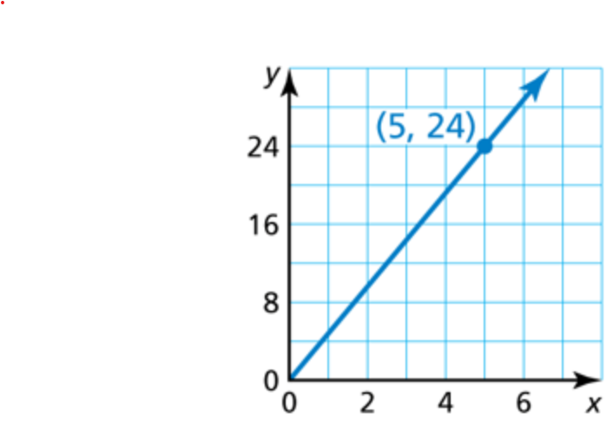
Fun example…
Interpret this graph…
What does this mean
or tell us?
Well, we have a line…
y-intercept is 0
Slope is $\frac{24}{5}$
…slope is positive/increasing
But what does x represent? Or what does y represent?
It really doesn’t tell us enough to interpret what it means or represents…

Slide 7
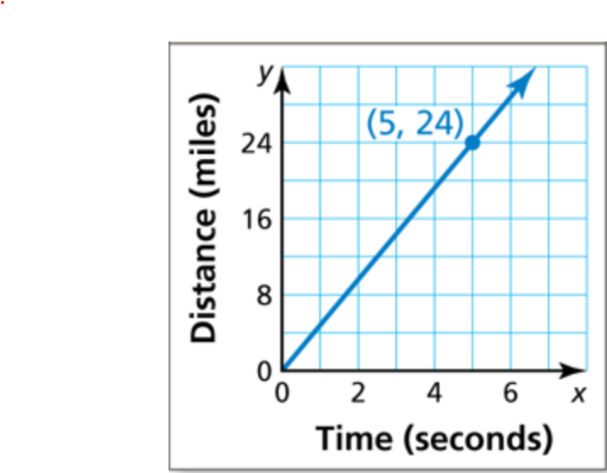
Fun example…
Interpret this graph…
What does this mean
or tell us?
The axis titles give us a bit more…
Graph relates time traveled (in seconds) to distance (in miles)
So this tell us how fast something moves

Slide 8
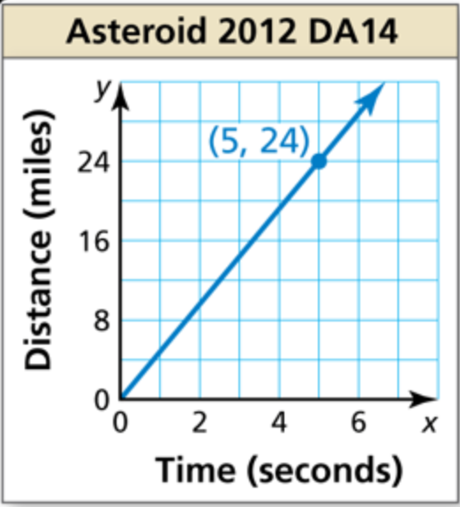
Fun example…
Interpret this graph…
What does this mean
or tell us?
This relates to an actual asteroid.
So it tell us how fast it moves
It came within 17,200 mi
of earth Feb 2013.
Relatively how close is that?
Moon is ~240,000 mi
Geostationary satellites ~22,000 mi
Space station 254 miles
Asteroid!!!
Satellites
Moon
Earth
17k
30k
60k
120k
240k
0
22k

Slide 9
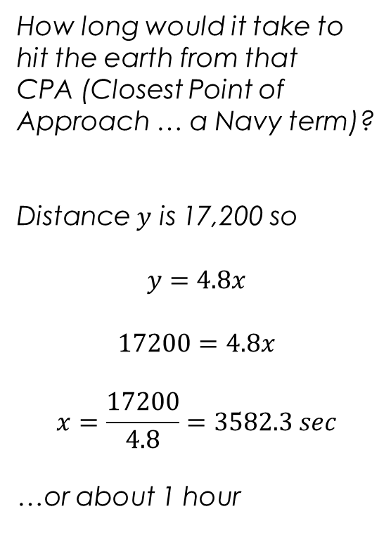
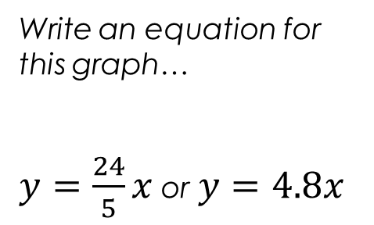
Fun example…
Write an equation for this graph…
$y=\frac{24}{5}x$ or $y=4.8x$
How long would it take to hit the earth from that
CPA (Closest Point of Approach … a Navy term)?
Distance $y$ is 17,200 so
$$y=4.8x$$
$$17200=4.8x$$
$$x=\frac{17200}{4.8}=3582.3 sec$$
…or about 1 hour

Slide 10
How to write the equation for a line when given different information:
Given slope m and y-intercept b
use slope-intercept form
$y=mx+b$
Given slope m and a point (x₁, y₁)
use point-slope form
$y−y_{1}=m(x−x_{1})$
Then solve for y and put into slope-intercept form
Given points (x₁, y₁) and (x₂, y₂)
First use the slope formula to find m
Then either:
use the point-slope form with either point
or plug one of the points and m into the slope-intercept form to solve for b and then use the slope-intercept form.

Slide 11
Do the Section 1.3 Monitoring Progress 1 (Writing Linear Equations in the Big Ideas online textbook. It will be in the Dynamic Classroom.
One the one page there are multiple questions … answer them all!
Use the provided keypad to enter your answer ESPECIALLY for equations/expressions.
At the bottom are three buttons:
Lightbulb: show answer
Checkbox: check answer
Question mark: get help
BIM can be stupid sometimes:
For the slope when you write the equation it is expecting (but not telling you) it wants decimal format.
The slope is -3/10 … if you enter it as a fraction (even though it is correct and a better format) it will say WRONG!
On tests I will be hand checking answers and will tell you which format I want the answer in.
Be patient, you will get this.

Slide 12
Lakeside Inn
Number of students, x | Total cost, y
100 | $1500
125 | $1800
150 | $2100
175 | $2400
200 | $2700
Two prom venues charge a rental fee plus a fee per student. The table shows the total costs for different numbers of students at Lakeside Inn. The total cost y (in dollars) for x students at Sunview Resort is represented by the equation
y $=$ 10x $+$ 600.
Slope is cost per student, y-intercept is base cost
Which venue charges less per student? How many students must attend for the total costs to be the same?
SOLUTION
Understand the Problem
Make a Plan
Compare slopes to determine which venue charges less per student.
Will need to calculate slope for Lakeside Inn…
Variable y represents total cost. To tell when the costs will be the same, set the equations equal to each other and solve.
Will need an equation that models the total cost at Lakeside Inn
Set the Lakeside equation equal to the Sunview one
You will have only x’s
Solving this will find the x (# students) that makes them equal

Slide 13
Solve the
Problem
Lakeside Inn
Number of students, x | Total cost, y
100 | $1500
125 | $1800
150 | $2100
175 | $2400
200 | $2700
Compare slopes.
1st find the Lakeside slope using any two points from the table.
Plan
Compare slopes to determine which costs less per student.
Note: calc slope for Lakeside
Compare equations to determine # students must attend for total cost to be same.
Let’s use: (x₁, y₁) $=$ (100, 1500)
(x₂, y₂) $=$ (200, 2700)
m $=$ $\frac{\text{y}\text{2} − \text{y}\text{1}}{\text{x}\text{2 }− \text{x}\text{1}}$ $=$ $\frac{\text{2700 }−\text{1500}}{\text{200 }−\text{100}}$ $=$ $\frac{\text{1200}}{\text{100}}$ $=$ 12
Comparing slopes, Sunview Resort charges $10 per student, which is less than the $12 per student that Lakeside Inn charges.

Slide 14
Solve the
Problem continued
Lakeside Inn
Number of students, x | Total cost, y
100 | $1500
Sunview equation: $y=10x+600$
Compare equations.
Write equation for Lakeside Inn using the slope of 12
and a point from the table.
Let’s use (x₁, y₁) $=$ (100, 1500).
Plan
Compare slopes to determine which costs less per student.
Note: calc slope for Lakeside
Compare equations to determine # students must attend for total cost to be same.
y $−$ y₁ $=$ m(x $−$ x₁)
Point-slope form
y $−$ 1500 $=$ 12(x $−$ 100)
Substitute for m, x₁, and y₁.
y $−$ 1500 $=$ 12x $−$ 1200
Distributive Property
y $=$ 12x $+$ 300
Add 1500 to each side.
Equate the cost expressions and solve.
10x $+$ 600 $=$ 12x $+$ 300
Set cost expressions equal.
300 $=$ 2x
Combine like terms.
150 $=$ x
Divide each side by 2.
The total costs are the same for 150 students.

Slide 15
Now do Example 2: Modeling with Mathematics in the online textbook.
You can watch a video talking you through the problem…
…and you can do a click-through showing every step (including hints for solving the problem!) for the way the book solves the problem. ☺
Next do Example 2 Monitoring Progress in the online textbook.
This will give you a 2nd but very similar problem to work through.

Slide 16
Okay, now go do your homework! ☺

